Slide 1
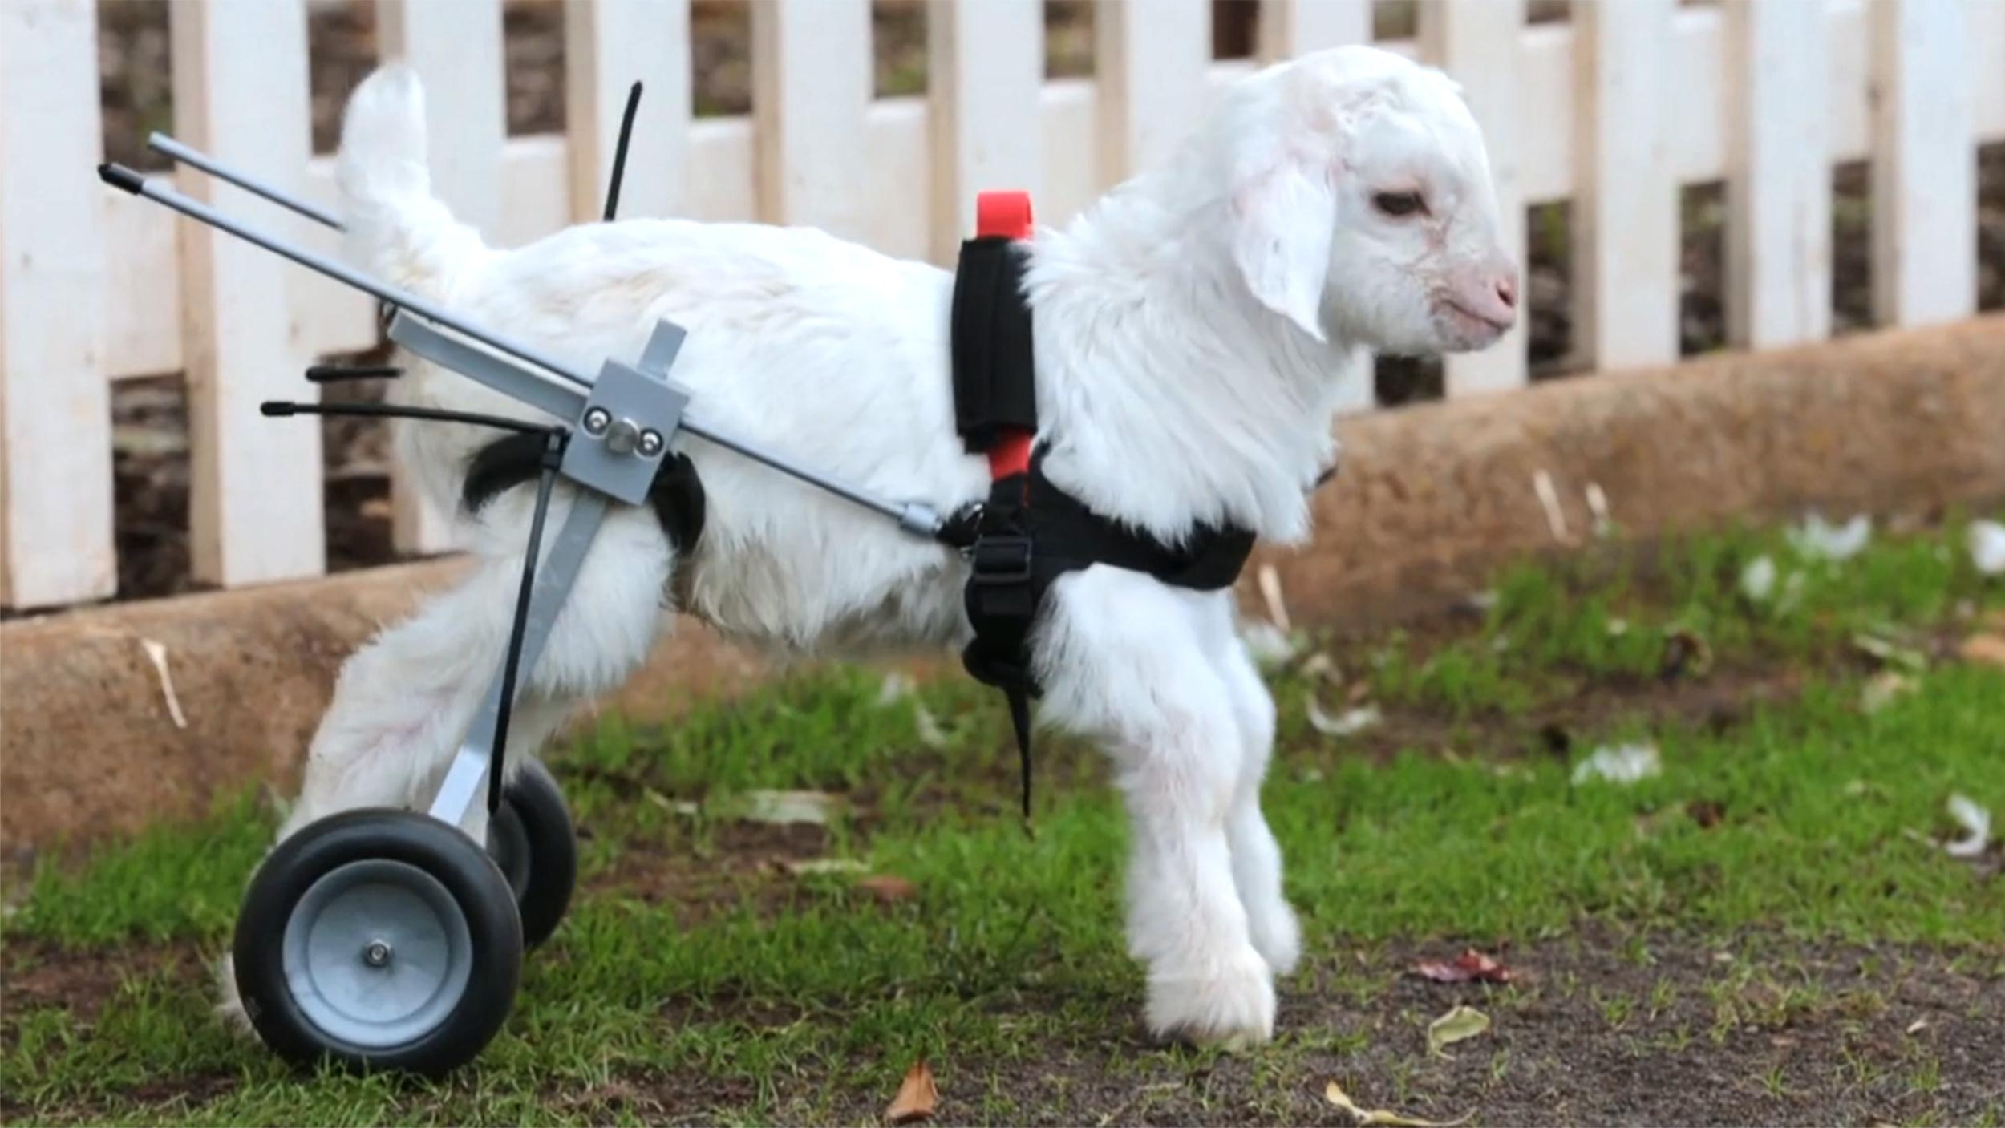
Designing for Diverse Populations CSCI 5839 Fall 2014
Notes:
RIP Frosty the Goat: http://media2.s-nbcnews.com/i/newscms/2014_21/459711/140522-frostie-goat-jsw-1201p_a069580b954597f7fa3412e5d5281960.jpg

Slide 2

Assignments etc.
Dec 11: ATLAS Expo (see Piazza post)
Need to get back to ATLAS soon
Next week: FALL BREAK
Only 3 more classes left D:

Slide 3
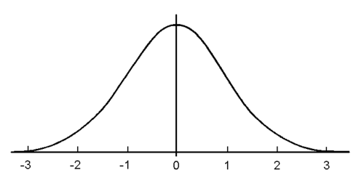
Today
Designing for users outside of the normal curve
Notes:
http://www.oxfordmathcenter.com/images/notes/300-00.gif

Slide 4
You are not your user
Users are different than you are
Understanding how and why (and what to do about it) will make your design better

Slide 5
What’s a “diverse population”?
Socioeconomic status
Gender identity / gender
Young people
Legal restrictions (personal data)
Parental permission
Older adults
Education
Language
Culture (privacy, norms)

Slide 6
What’s a “diverse population”?
People in wheelchair, visual impairments, hearing impairments
Culture – thinking? language
Learning style
Ages: little kids, elderly, young adults
Ability: technical ability, language, physical ability, cognitive
Access to technology, infrastructure
Socioeconomic status

Slide 7
Terms
Accessibility – typically about people who have disabilities (visual, physical, auditory, cognitive, language)
Assistive technology – specific technology that a person with a disability uses to overcome accessibility problems

Slide 8
Definition: (web) Accessibility
Web accessibility means that people with disabilities can use the Web. More specifically, Web accessibility means that people with disabilities can perceive, understand, navigate, and interact with the Web, and that they can contribute to the Web.
http://www.w3.org/WAI/intro/accessibility.php

Slide 9
Approaches
Assistive technology: create a way for someone who is disabled (or otherwise excluded) to access the inaccessible technology
Screen reader software for computer
Wheelchair ramp for building stairs
Universal design: design something from the start to support a wide audience
Design app to provide built-in speech feedback
Design building to have entrances at ground level

Slide 10
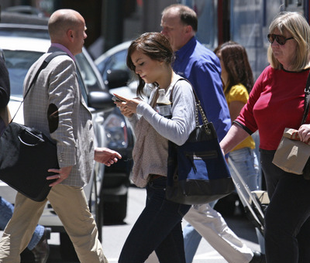

Is disability constant?
People can be “situationally impaired”

Slide 11
Situational impairments (Sears and Young 2002)
Light levels
Noise
Wind/dirt/stuff
Movement
Wearing bulky equipment

Slide 12
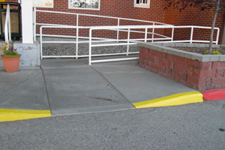
Incidental benefits

Slide 13
Arguments for accessibility
Economic argument
Reach a large audience
Makes you look good
Moral argument
Participation from a diverse group is good
Legal argument
Laws requiring equal access of public resources (Americans with Disabilities Act, Section 508)
Many legal cases (big companies: Target, Amazon…)

Slide 14
Legal support for accessibility
1990: Americans with Disabilities Act (ADA)
1998: Rehabilitation Act (section 508)
2006: Individuals with Disabilities Education Act (IDEA)
http://webaim.org/articles/laws/usa/

Slide 15
Legal Cases
1996 ADA complaint vs. City of San Jose, CA
Use of PDF inaccessible to city commissioner
Web sites are a “service” and thus subject to the ADA
Led to S. J. Web Page Disability Access Standard
1999 National Federation of the Blind vs. AOL
Based on the interpretation of the Web as a place of public accommodation (ADA)
Settled out of court
2000: AOL agreed to make its browser accessible
2006 NFB vs. Target
ADA as applied to Target’s web site
Settled for US $6 million

Slide 16

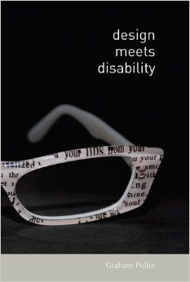
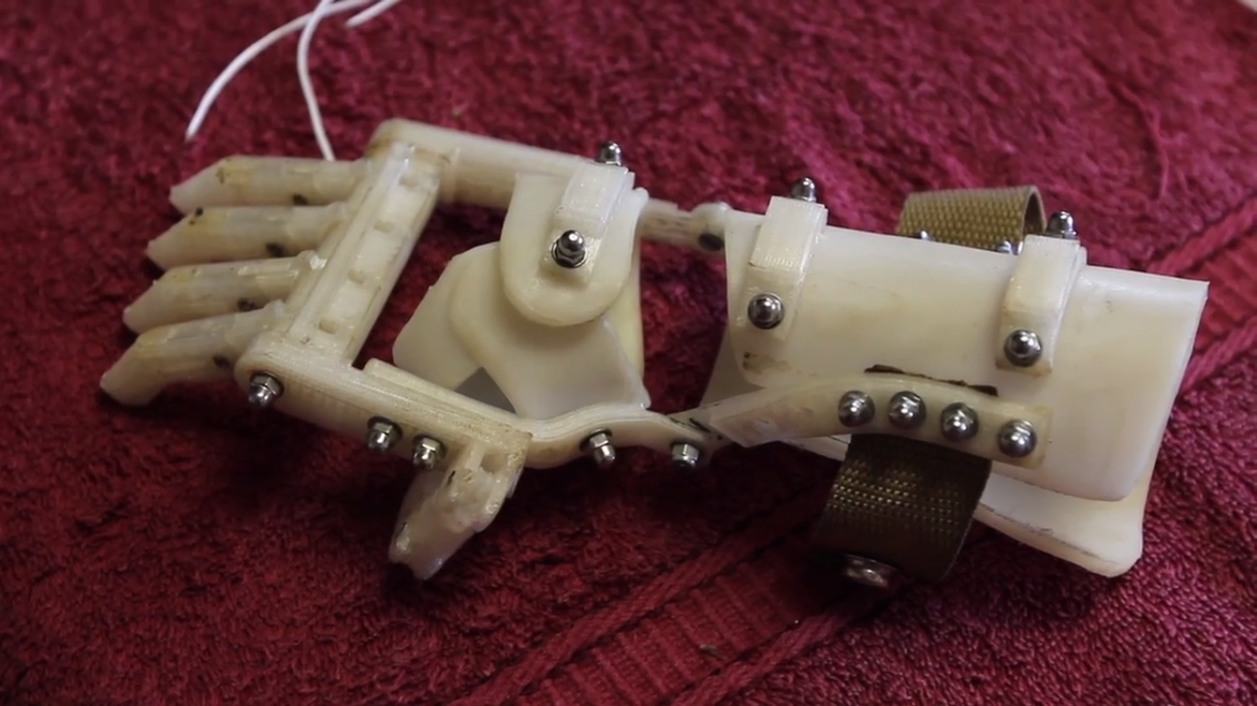
Argument from cool design

Slide 17
Designing for accessibility

Slide 18
Designing for accessibility
User involvement is key
BUT working with people with disabilities is time consuming
Use personas to guide design
But base them on real data
Follow design guidelines for specific disabilities

Slide 19
Who is affected?
People with disabilities (visual, hearing, motor, cognitive, reading)
About 1 in 5 adults (webaim.org/intro)
Older adults – up to 50% of computer users may benefit from accessibility features (http://www.microsoft.com/enable/research/)
“Situational impairments” – mobile device users, temporarily injured people
Sometimes it’s just convenient – reading transcripts vs. watching a video

Slide 20
YouTube can help!
Screen reader demo: https://www.youtube.com/watch?v=2PMuBQ7LyOw
Touch screen head pointer: https://www.youtube.com/watch?v=26G4qXB2j4g

Slide 21
Categories of Impairments
Cognitive (Learning Disability, memory, reading)
Mobility (Physical)
Hearing
Speech
Visual
(slides adapted from a lecture by Michele Williams @UMBC)
Notes:
As we talk about universal design and making things accessible we need to begin considering what abilities people may not have that affect how they use technology

Slide 22
Considerations for Cognitive Impairments
Short term memory storage: 7+- 2
Don’t rely on your user to remember large amounts of information, or complex steps
Distraction / Task Decomposition
Consider users who have difficulty focusing
Make tasks shorter, simplify designs
Socialization
Some children with autism may not be comfortable looking at faces

Slide 23
Considerations for Mobility Impairments
Keyboard accessibility
Users can access and activate everything on the page with solely the keyboard
Speech recognition compatibility
Proper code structure is a must
Provide ample time for tasks
Provide shortcuts
“Skip Navigation” links

Slide 24
Considerations for Hearing Impairments
Use structured pages
Use headings and subheadings
Use bulleted lists
Write clearly
Keep language short, simple, and to the point
Write in active voice
Avoid jargon and/or provide definitions
Provide alternatives to audio
Text, captions, or even sign language interpreters
TTY-enabled customer service lines

Slide 25
Considerations for Speech Impairments
Provide alternatives to speech
Chat rooms and email as well as telephone numbers for customer service (at the same level of service)
Provide cues to get people started
May be able to speak, but have difficulty constructing freeform text

Slide 26
Vision impairments

Slide 28
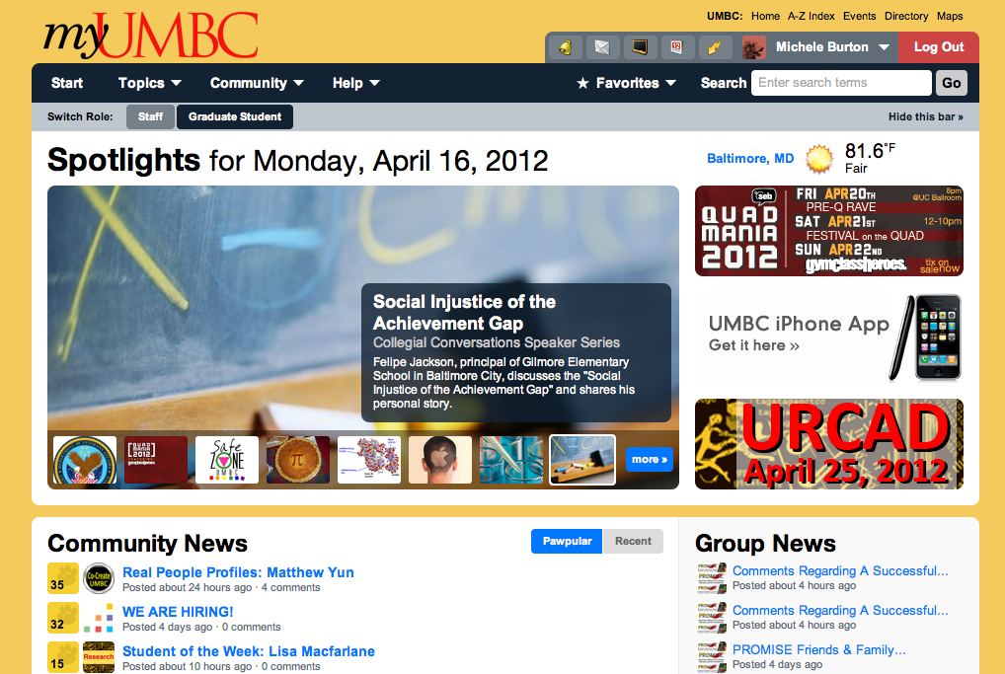

Notes:
Some people with vision impairments see things fuzzy until they zoom in

Slide 29
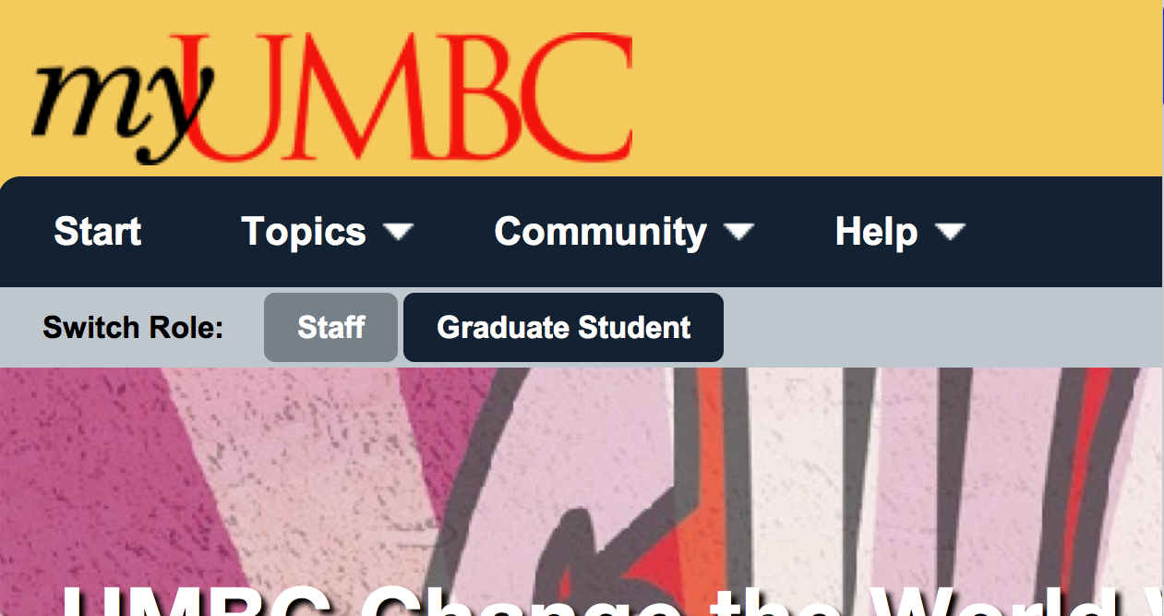
Notes:
Zoomed in view for people with low vision

Slide 30
Notes:
Some only see in gray or need to see in gray (or other colors such as blue and yellow)

Slide 31
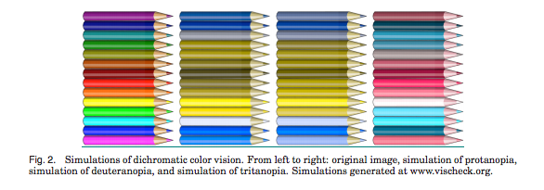
Color blindness
Affects 10% of males
Multiple variations
D. Flatla et al

Slide 32
Considerations for Visual Impairments
Use text instead of images of text
Use CSS to style text (Logos are exceptions)
Keyboard accessibility
Don’t override keystrokes
Users can access and activate everything on the page with solely the keyboard
Skip navigation links

Slide 33

Considerations for Visual Impairments
Have alternatives to color
Required fields in red
* denotes required fields
Provide sufficient color contrast

Slide 34
Considerations for Visual Impairments
Provide ample time for tasks
Provide shortcuts
Notes:
Can’t use a mouse!

Slide 35
WCAG: Web Content Accessibility Guidelines
Perceivable
Provide text alternatives for non-text content and provide captions and alternatives for audio and video content.
Make content adaptable; and make it available to assistive technologies.
Use sufficient contrast to make things easy to see and hear.
Operable
Help users find content and make everything keyboard accessible.
Give users enough time to read and use content.
Do not use content that causes seizures.
Understandable
Make text and content understandable, and readable
Make content operate in predictable ways. and help users avoid and correct mistakes.
Robust
Maximize compatibility with current and future technologies.
http://www.w3.org/WAI/intro/wcag.php
Notes:
Explains how to make Web content accessible to people with disabilities.

Slide 36
Extensions to WCAG
WCAG 2 http://www.w3.org/TR/WCAG20/
ARIA http://www.w3.org/WAI/intro/aria

Slide 37
Effects of assistive devices
People with disabilities may use technology that affects your user interface
Visual: Screen readers, magnifiers, large type
Motor: alternative input devices, styli
Hearing: captioning

Slide 38
More examples of AT use
Louise, cerebral palsy
http://www.youtube.com/watch?v=KtAHzRu1OF0
Ben, head pointer
http://www.youtube.com/watch?v=p9NsV39nq8U
University of Washington DO-IT
http://www.washington.edu/doit/Video/

Slide 39
Verifying accessibility
User testing is the best way
Heuristic evaluation can help
http://webaim.org/intro/#principles
http://webaim.org/standards/wcag/checklist
Automated checker: http://achecker.ca/
Simulating disability
http://vischeck.com/
http://firevox.clcworld.net/
http://www.chromevox.com/
http://webanywhere.cs.washington.edu/

Slide 40
Takeaways
Lots of people may experience accessibility problems
It can help to understand accessibility challenges (and how people overcome them)
Resolving them can help result in a better design

Slide 41
Accessibility activity
How would your application (or part of it) work as a non-visual app?
Audio and haptic feedback
Touch input
Sketch a storyboard for this type of interaction for one task in your app
We’ll act it out!
Notes:
Impairments: visual, audio, cognitive, language, older, multiple

